Slide 1
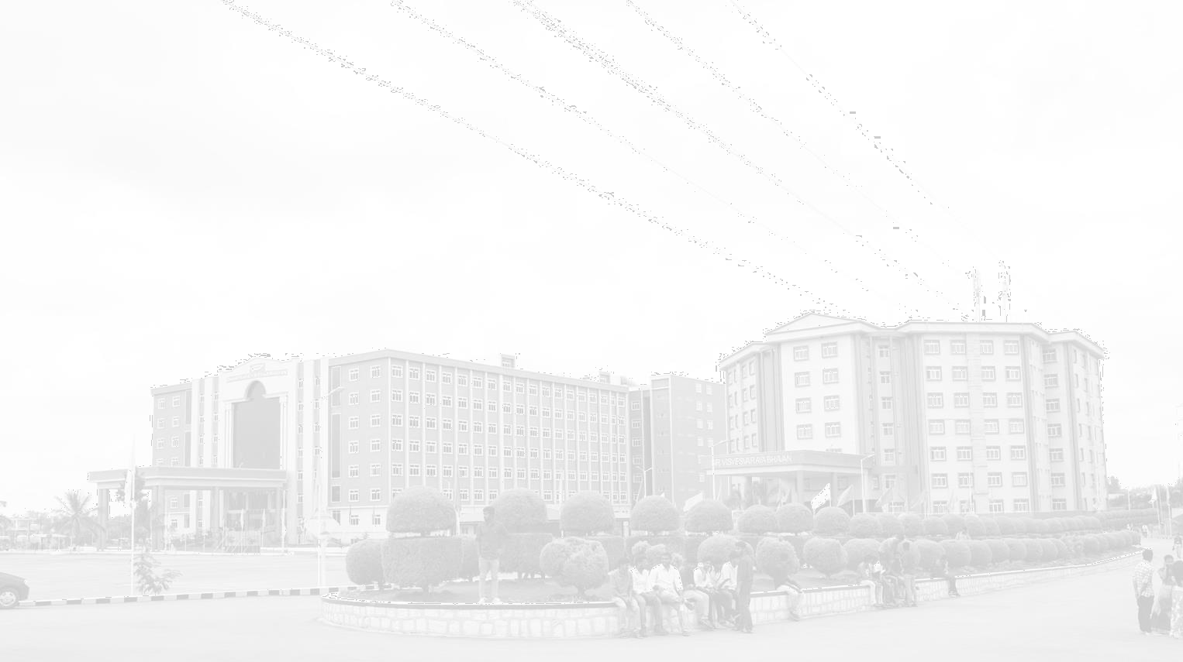


Image & video processing ,analysis of traffic signal areas using deep learning ,AI Models
GITAM UNIVERSITY
A University should be a place of light, of liberty, and of learning.
AY 2021-25
Major Project
Project ID: XX
Department of Electrical Electronics and Communication Engineering
Project Mentor:
Sanhita Manna
Project Team:
BU21EECE0100515 P Lakshmi Vignesh BU21EECE0100104 Moda SriRangaManjula BU21EECE0100487 Lalam Jithendhra
www.gitamedu.com

Slide 2


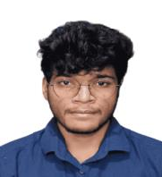


Project Group – Details
Photo
Track
Roll No
Name
EECE
BU21EECE0100515
P Lakshmi Vignesh
EECE AI/ML
BU21EECE0100104
Moda SriRangaManjula
EECE
BU21EECE0100487
Lalam Jithendhra
2

Slide 3
Objective and Goals
Objective
Objectives
This project involves developing a machine learning model that utilizes object detection techniques to analyze vehicle density across traffic lanes. An algorithm will be designed to display identified high priority vehicles at traffic junctions, enabling reduced emergency rate and accurate predictions of the time required to clear each lane and improving overall traffic management efficiency.
Goals
Main Goals
To assign the time to each lane (i.e 5<=time<=120) by analyzing the vehicle density of that lane.
To prioritizing the high priority vehicles identified while analyzing the vehicles and displaying them to clear path for those
vehicles in that lane.
Additional goals
To reduce the emergencies for people by prioritizing the high priority vehicles.
To reduce the time for which the vehicles are waiting at traffic junctions.
3

Slide 4
ABSTRACT:
In any part of our life, each of us has encountered high-priority vehicles like ambulances, fire engines, and police vehicles waiting during their time of emergency. We have also experienced waiting for 90 seconds at traffic signal lanes even if the other lanes are empty.
We can save significant time and prioritize vehicles at traffic signals by analysing and executing better algorithms with the help of video processing and Al models.
The main motto of this project is to eliminate the excess time and prioritize the vehicles at the traffic signals. This can be achieved by training deep learning models.
Firstly, the models will analyse the density of the vehicles at each lane of traffic areas. Additionally, the models will identify high priority vehicles such as ambulances and fire engines. Based on the density of vehicles, the models will then assign time to each lane, ensuring the time assigned is within the range of 5 to 120 seconds.
Finally, traffic signal control systems need to be integrated with the Al models to dynamically adjust signal timings based
on real-time traffic conditions and the presence of high- priority vehicles
4

Slide 5
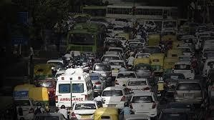
INDRODUCTION: This problem statement revolves around the need to develop an advanced system that can automatically monitor, process, and analyze images and videos from traffic signal areas. By applying image and video processing, deep learning, and AI to analyze the vehicle densities to predict the time required for that lane and to identify the high priority vehicles and to prioritize them at traffic junctions. Which reduces the emergency rate which can save lives by reducing the waiting time and also results in time effective advancement at traffic junctions.
5

Slide 6
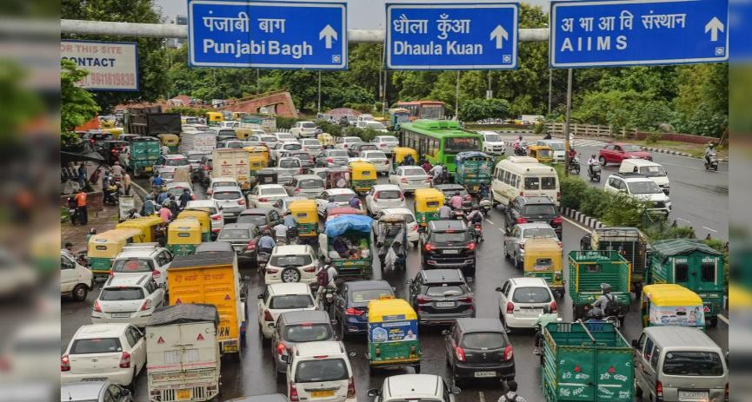
Project Plan
Software/Hardware
Though this project mostly comprises of software technologies, it is an integration of hardware too. This project is to be implemented at traffic junctions.
Software Requirements
Object detection AI
Object Classification AI
Video processing
Image preprocessing
Vehicle density Analysis
Hardware Requirements
CCTV cameras
LED displays
Security cameras

Slide 7
Methodology - block diagram :
Real time Video Capturing at traffic Junctions
Video processing through AI
Vehicle density
Analysis
Identifying High
priority vehicles
Prediction of time required to clear the lane(5<t<120)
Vehicle detection through YOLO model
Vehicle classification through CNN

Slide 8
.
Assigns the predicted time to that lane
Displayin g the identified vehicles
Make sures no high priority vehicles is waiting
Makes path to the displayed vehicle by traffic police
Turns the red light -> Yellow
-> Green

Slide 9

Analysis - SWOT
Strengths
Real-time Vehicle Density Analysis
Prioritization of High-Priority Vehicles
Improved Traffic Management
Integration of Software and Hardware
Weaknesses
Dependence on High-Quality Hardware
Complexity of Implementation
Data Privacy and Security Concerns
Maintenance Requirements
Threats
Opportunities
High Initial Costs
Regulatory and Compliance Challenges
Resistance to Change
Scalability to Other Cities
Potential for Integration with Smart City
Expansion to Additional Use Cases
Collaboration with Government and Private Sectors
Initiatives

Slide 10
Analysis – 4W1H
Why: The main goal is to reduce congestion and waiting times at traffic junctions by dynamically managing the traffic light timings based on real-time vehicle density analysis. Ensuring that high-priority vehicles like ambulances and fire trucks have a clear path, thereby reducing the response time during emergencies.
What: : The project involves developing a machine learning-based system for detecting and classifying vehicles, analyzing vehicle density, and managing traffic signals accordingly. Utilizing video and image preprocessing techniques to analyze traffic conditions in real time.
Where: The system is designed to be implemented at traffic junctions, particularly in busy urban areas, to optimize traffic flow and enhance safety.
When: The system is designed to be implemented at traffic junctions, particularly in busy urban areas, to optimize traffic flow and
enhance safety.

Slide 11
How: The system will use CCTV cameras and other security cameras installed at traffic junctions to capture real-time video footage. The system will use CCTV cameras and other security cameras installed at traffic junctions to capture real-time video footage. Deploying machine learning models to analyze the captured footage and make decisions regarding traffic light timings and high-priority vehicle management.
Refined Objective: To Develop an AI-Powered Traffic Management System that Enhances Traffic Flow and Safety by Dynamically Adjusting Traffic Signals Based on Real-Time Vehicle Density and Prioritizing High-Priority Vehicles at Traffic Junctions. This system aims to reduce minimize emergency response times, and improve overall traffic efficiency
.

Slide 12









Architecture
Structural Diagram
Block Diagram/Pin Diagram
DATASETS
LABELLING AND ANNOTATING
Preprocessing of Images
Data Augmentation
Model Training

Slide 13
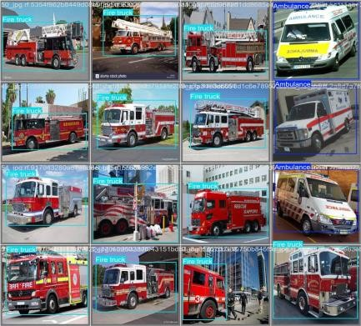
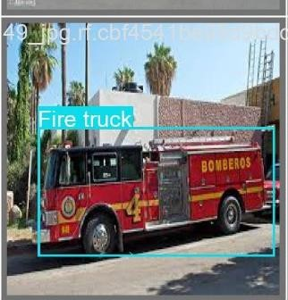
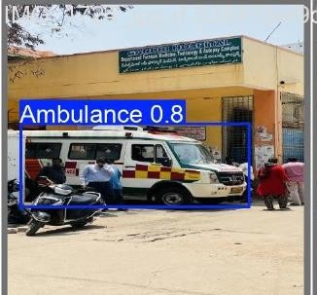
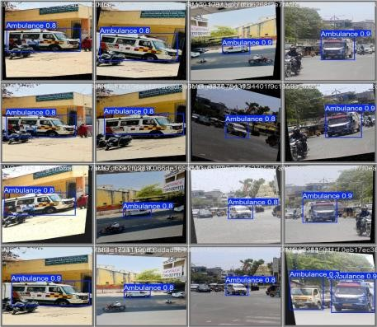
Use Cases & Testing
Use Cases:
Use Case 1 – Multiple Vehicle Detection with Prioritization:
Multiple vehicles (e.g., cars, fire engines, ambulances) are detected at an intersection.
Action: The system classifies the vehicles by priority, giving emergency vehicles (like fire engines or ambulances) the highest priority.
Expected Outcome: The lane with the high-priority vehicle is cleared first, and signal timings are adjusted based on vehicle density.
Use Case 2 – Vehicle Distance and Time Assignment:
Scenario: The system detects vehicles at varying distances from the traffic signal.
Action: Based on the distance of vehicles and lane density, the system assigns traffic signal times dynamically (5-120 seconds).
Expected Outcome: Vehicles closer to the signal get higher priority, optimizing traffic flow and minimizing waiting time.

Slide 14
TESTING
Test Case 1 – Greyscale and Augmentation Impact on Detection:
Objective: Test how augmentation techniques (greyscale conversion, blurring, noise addition) impact the detection accuracy.
Process: Compare the performance of models trained with greyscale and augmented images to those trained on original images.
Expected Outcome: The augmented models (with greyscale, blur, noise) provide more robust detection in real-world conditions, especially under low-quality or
noisy data.
Test Case 2 – YOLOv11n Object Detection Model:
Objective: Test the accuracy of YOLOv11n for detecting vehicles such as ambulances, fire engines, and regular cars in real-time.
Expected Outcome: The model correctly detects vehicles with at least 90% accuracy under different conditions.
Test Case 3 – Epoch Testing for Model Performance:
Objective: Test model performance across different epoch settings (10, 20, 50).
Process: Train the model for 10, 20, and 50 epochs. Evaluate its performance in terms of accuracy, detection speed, and error rates.
Expected Outcome: The model performs best at 50 epochs, balancing accuracy and training efficiency.
Test Case 4 – Traffic Signal Timing Based on Vehicle Density:
Objective: Test the system’s ability to assign appropriate traffic signal timings based on the vehicle density.
Process: Simulate traffic with varying vehicle densities and observe if the time assigned is within the 5-120 seconds range.

Slide 15
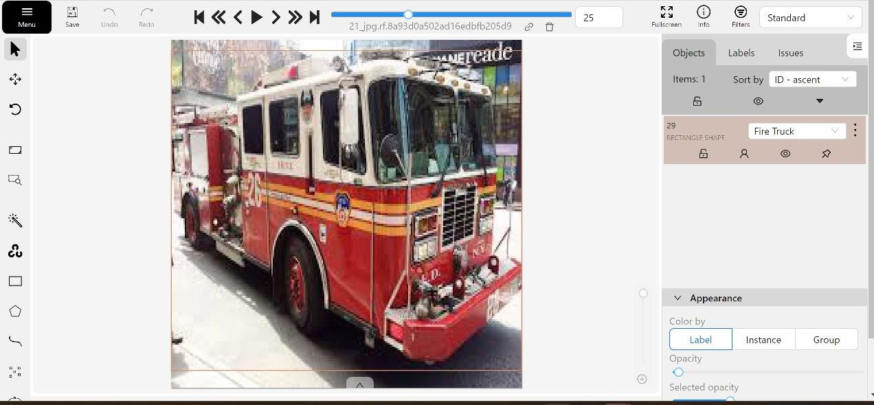
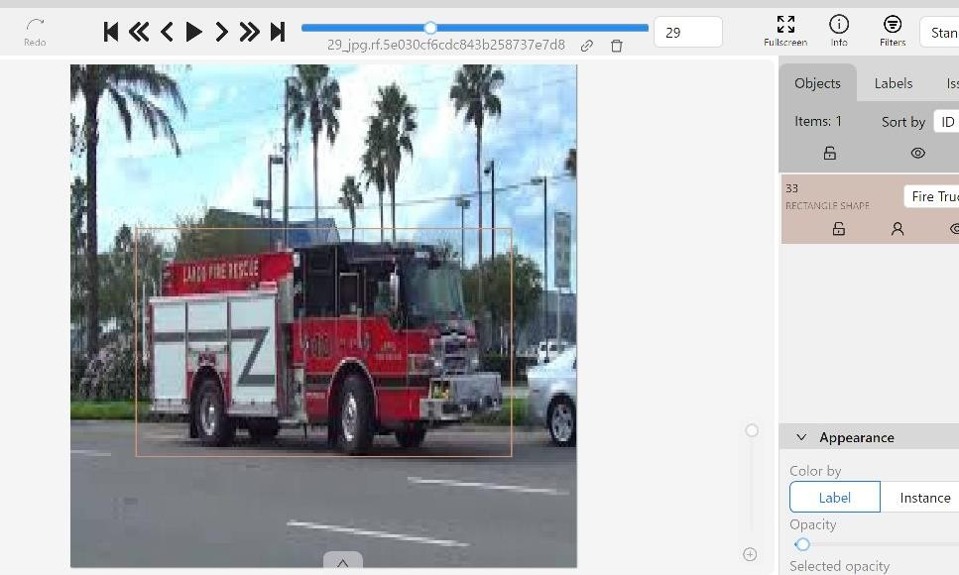
Implementation and Results – Iteration 1
Implementation:
Dataset Collection:
Collected datasets from Kaggle, Roboflow, and open-source image datasets containing vehicle images for training the model.
Image Labeling and Annotation:
Used the CVAT.ai platform to label and annotate the vehicle images for the training process. This included drawing bounding
boxes around vehicles like ambulances, fire engines, and other regular cars.
13

Slide 16
.Preprocessing of Images:
Resized all images to a fixed resolution of 640 x 640 pixels to maintain uniformity.
Applied auto-orientation to correct any misaligned images.
Converted some images to greyscale and performed basic data cleaning as part of preprocessing.
. Data Augmentation:
Performed data augmentation to improve the model's ability to detect vehicles in different conditions:
Converted 15% of the images to greyscale.
Applied blur to some images.
Added noise to other images to improve detection under various conditions.

Slide 17
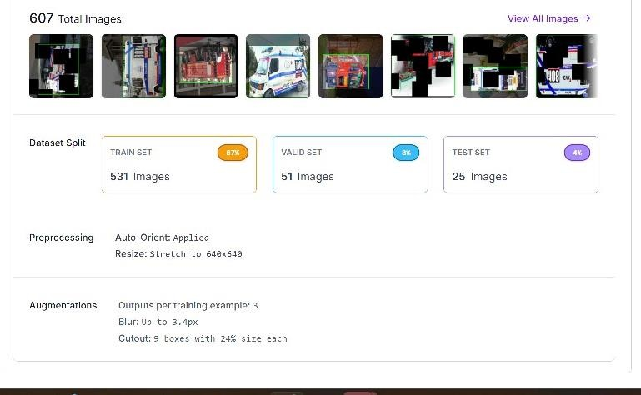

Slide 18
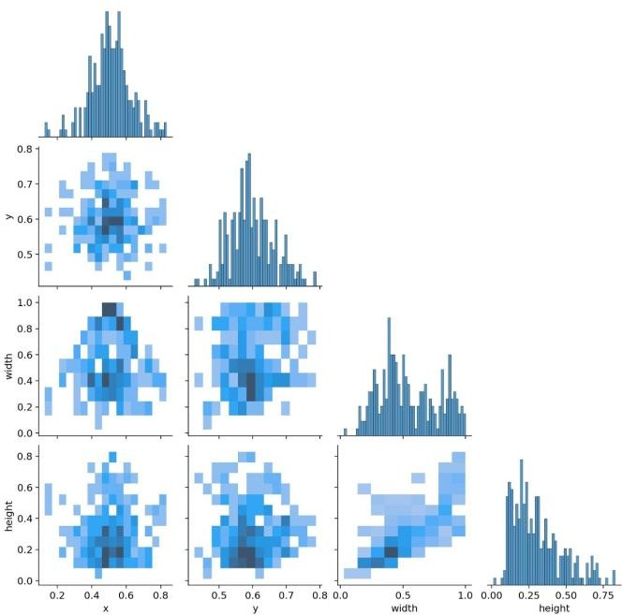
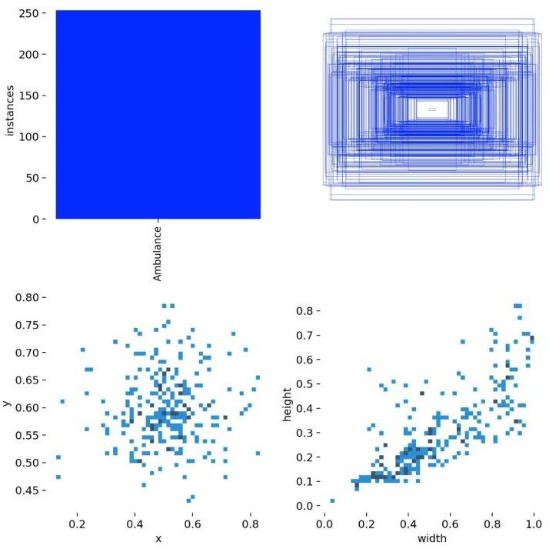
5 . Model Training:
Used YOLOv11 Object Detection Model to train the AI system for detecting vehicles.
Initially tried YOLOv11m but faced compatibility issues, switched to YOLOv11n for better performance.
Trained the model with 150 epochs, but later adjusted to 50 epochs, which provided the best results.
Used various training iterations (10, 20, 50 epochs) to fine-tune model performance.

Slide 19
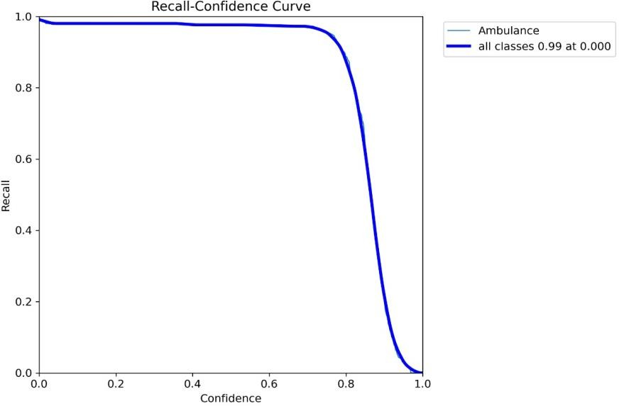
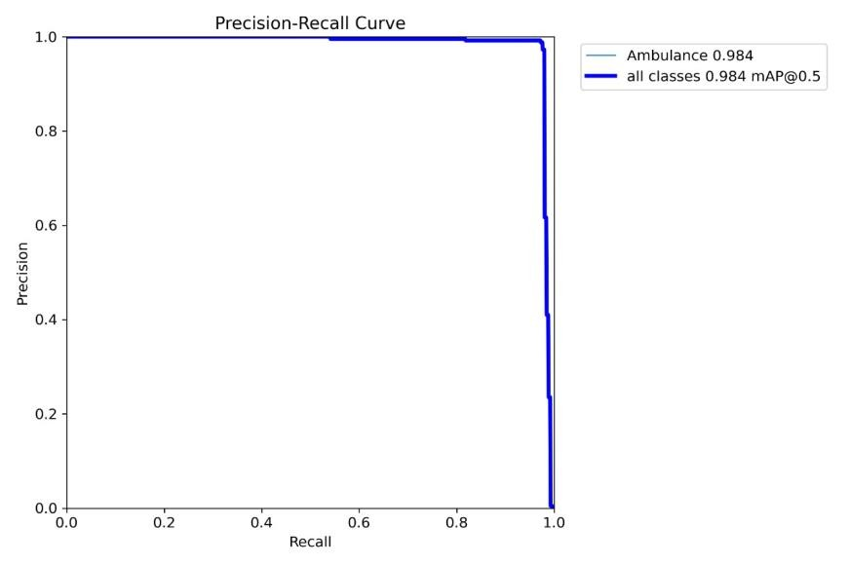
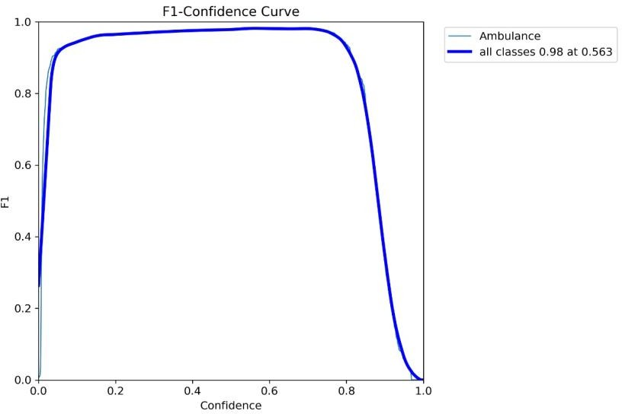
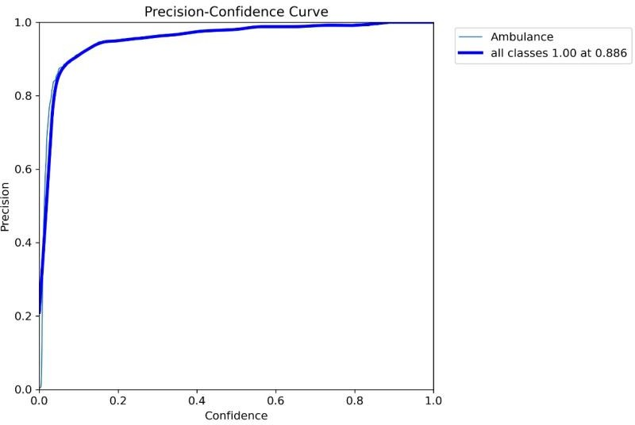
17

Slide 20
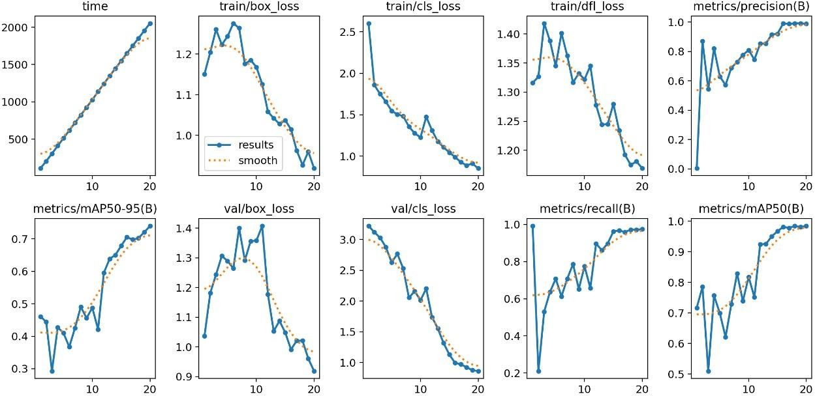

Slide 21
Implementation and Results – Iteration 2
Iteration : Results + Validation against the use cases and test cases
Iteration 1 – YOLOv11n with 10 Epochs
Objective: Test initial object detection accuracy and performance.
Result: The model did not perform as expected. It failed to detect vehicles accurately, especially in real-time conditions.
Iteration 2 – YOLOv11n with 20 Epochs:
Objective: Improve detection accuracy by increasing the number of epochs.
Result: The model showed slight improvement but still had issues with accuracy, especially with detecting smaller vehicles and under noisy or blurry conditions.
Iteration 3 – YOLOv11n with 50 Epochs:
Objective: Optimize model performance with 50 epochs and further data augmentation.
Result: The model achieved significant improvements, with over 90% accuracy in detecting vehicles such as ambulances, fire engines, and regular cars. It performed well in real-time, even in varied lighting and environmental conditions.
Validation:
Use Case Validation: The model successfully detected high-priority vehicles and adjusted traffic signals dynamically, as per the defined use
cases.
Test Case Validation: The system passed all critical test cases, including vehicle detection under noise, blur, and various environmental conditions. The performance in terms of accuracy and real-time object detection was validated to be within the desired range.

Slide 22
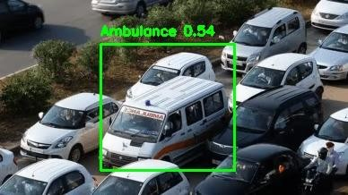
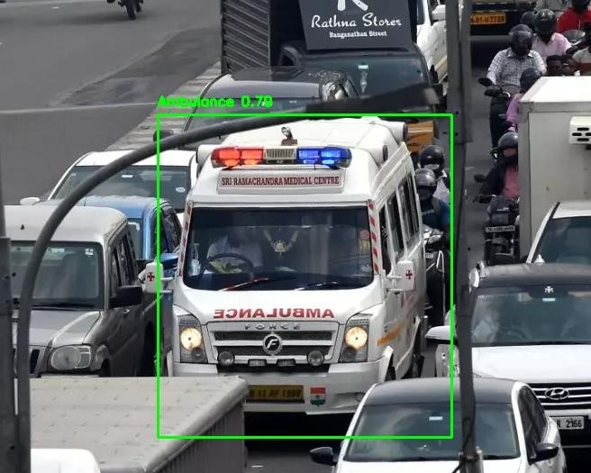
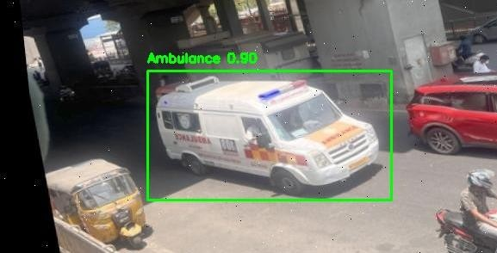
Implementation and Results – Iteration 3 (Optional)
Results:
The final YOLOv11n model, after 50 epochs, was able to accurately detect ambulances, fire engines, and regular vehicles with high precision.
The model was able to achieve over 90% detection accuracy, making it highly reliable for real-time traffic management.

Slide 23
Contribution
Team Progress and Movement
Dataset Collection
Data labelling and Annotation
Model Training
Testing
Individual Contribution
Key contributions: Putlooru Lakshmi Vignesh
AI Model Training
Model Testing
Key contributions: Lalam Jithendra
Dataset Collection
Model Testing
Key contributions: Moda Sri Ranga Manjula
Data labelling and Annotation
Model Testing

Slide 24
Conclusion & Future Work
Summary and Conclusion :
Summary:
In this project, we developed a smart traffic management system capable of real-time vehicle detection using advanced YOLOv11 models.Data augmentation techniques such as greyscale conversion, blurring, and noise addition were applied to improve the model's robustness.
Through several iterations, we improved the model's accuracy, achieving over 90% detection accuracy after training for 50 epochs.The system successfully detects ambulances, fire engines, and other vehicles, adjusting traffic signals dynamically in real- time based on vehicle priority and proximity.
Conclusion:
The implemented YOLOv11n model, after various iterations and augmentations, provides reliable and accurate vehicle detection, ensuring smooth traffic flow and prioritization of emergency vehicles. This system is adaptable to real-time conditions, making it a strong candidate for deployment in smart traffic management systems
Future Work:
In future work, we aim to increase the accuracy of detecting fire engines and further enhance the system's performance.
Additionally, we will work on finding the distances of high-priority vehicles from traffic signals. Based on this, the system will dynamically assign traffic signal time to prioritize emergency vehicles efficiently. This will lead to better traffic optimization and quicker response times for emergency services.

Slide 25
References
REFERENCES
[1] Nellore K., Melini S.B. Automatic Traffic Monitoring System Using Lane Centre Edges. IOSR J. Eng. 2012; 2:1–8. [iosrjen]
[2] Sangamesh S B, Sanjay D H, Meghana S, M N Thippeswamy “Advanced Traffic Signal Control System for Emergency Vehicles” International Journal of Recent Technology and Engineering (IJRTE) ISSN: 2277-3878, Volume-8 Issue-3, September 2019 [IRJET]
[3] R. Bharadwaj; J. Deepak; M. Baranitharan; V. V. Vaidehi. “Efficient dynamic traffic control system using wireless sensor
networks” Doi: 10.1109/ICRTIT.2013.6844280 [IEEE]
[4] Krishnendu Choudhury; Dalia Nandi “Detection and Prioritization of Emergency Vehicles in Intelligent Traffic Management System” 2021 IEEE Bombay Section Signature Conference (IBSSC) DOI: 10.1109/IBSSC53889.2021.9673211 [IEEE]
[5] Lingani, Guy M., Danda B. Rawat, and Moses Garuba. "Smart traffic management system using deep learning for smart city
applications." 2019 IEEE 9th annual computing and communication workshop and conference (CCWC). [IEEE] , 2019.

Slide 26

THANK YOU

